Slide 1
RAJALAKSHMI ENGINEERING COLLEGE
Department of Artificial Intelligence and Data Science
IT19541 Web Technology
MINI PROJECT
Lost and Found Portal
Project by,
Benjamin Nicolas S (221801005)
Charless Binny K (221801007)
Date Slide Number

Slide 2
OUTLINE
Objectives
Abstract
Introduction to Problem Domain
Existing system
Limitation of the Existing System
Proposed system
Architectural design for Proposed system
Advantages of the Proposed System
Results and Discussions
Conclusion
Date Slide Number

Slide 3
OBJECTIVE
The objective of this Lost & Found Portal project is to create a centralized web-based system that allows university students and staff to easily report and search for lost or found items. Built using PHP and MySQL, the platform provides users with intuitive forms to submit item details, a secure login and registration system, and a searchable database of reported items. It aims to streamline the process of reconnecting owners with their belongings through automated matching, user-friendly interfaces, and essential administrative tools for managing reports efficiently.
Date Slide Number

Slide 4
ABSTRACT
This project presents a PHP-MySQL-based Lost & Found Portal designed to assist university communities in efficiently managing lost and found item reports. The system allows registered users to report lost or found items by submitting relevant details such as item name, location, and date. It integrates a secure login system, a searchable interface for browsing reported items, and an automated matching mechanism to help users identify potential matches between lost and found reports. Admin features enable user and report management, while email notifications alert users when a matching item is found. The platform enhances transparency, reduces manual tracking efforts, and improves the chances of item recovery in a campus environment.
Date Slide Number

Slide 5
INTRODUCTION TO PROBLEM DOMAIN
In university campuses, the frequent misplacement or loss of personal belongings poses a recurring problem for students and staff, often resulting in frustration, wasted time, and financial loss. Traditional methods of managing lost and found items—such as notice boards or manual logs—are inefficient, prone to human error, and lack real-time accessibility. With the growing reliance on digital solutions, there is a clear need for a centralized, user-friendly platform that can streamline the process of reporting, tracking, and retrieving lost or found items. Addressing this need, the Lost & Found Portal leverages web technologies to provide an organized and accessible system that bridges the gap between item loss and recovery, improving communication and accountability within the campus community.
Date Slide Number

Slide 6
EXISTING SYSTEM
Most educational institutions manage lost and found items through manual methods like verbal reports, notice boards, or handwritten logs, which are time-consuming, unstructured, and lack proper documentation. These traditional systems offer no efficient way to match or notify users, leading to poor recovery rates. The absence of a centralized digital platform results in poor coordination and limited accessibility. This project aims to replace these outdated practices with a more efficient, searchable, and automated online solution.
1. Foundrop
A cloud-based lost and found software used by law enforcement, airports, and universities. It allows organizations to log found items, match them with lost item reports, and communicate with the owners via a secure system.
2. Crowdfind
Used by events, theme parks, and transportation systems, Crowdfind lets users upload photos and details of lost or found items. It features a searchable public portal, image-based matching, and internal management tools.
3. MissingX
An international lost property platform connected with major transport hubs (e.g., airports and train stations). Users can register lost items and get notified if a match is found in the system.
Date Slide Number

Slide 7
LIMITATIONS OF EXISTING SYSTEM
Sr. No | Limitation
1 | Lack of Real-Time: AccessInformation about lost or found items is not updated or accessible in real time, delaying recovery efforts
2 | No Search or Match Functionality: Users cannot search for items or automatically match lost and found reports, making identification difficult.
3 | Poor Documentation: Manual logs are often incomplete, disorganized, or prone to loss, leading to confusion and inefficiency.
4 | Limited Notifications: There is no way to notify users when a matching item is found, reducing the chances of item recovery.
5 | Inaccessible Off-Campus: Physical logs and notice boards can only be accessed on-site, making it hard for students or staff who are off-campus to report or check updates.
Date Slide Number

Slide 8
PROPOSED SYSTEM
The proposed system is an online Lost & Found Portal built using PHP and MySQL, designed to help university communities efficiently manage and recover lost or found items. Users can register, log in, and submit reports with detailed item information. The system supports searching, automatic matching of reports, and email alerts to improve item recovery. It also provides an admin interface for managing users and item logs.
Key Features
User Registration & Login – Secure access control for users to manage their reports.
Lost & Found Item Reporting – Forms to submit item details, including date, location, and description.
Search & Filter Functionality – Users can search and filter items based on keywords, date, or location.
Matching Algorithm – Automatically detects similarities between lost and found reports.
Email Notifications – Sends alerts to users when a potential match is found.
Admin Dashboard – Allows administrators to view, verify, and manage all user-submitted reports.
Responsive Design – Built with Bootstrap for a mobile-friendly, clean user interface.
Date Slide Number

Slide 9
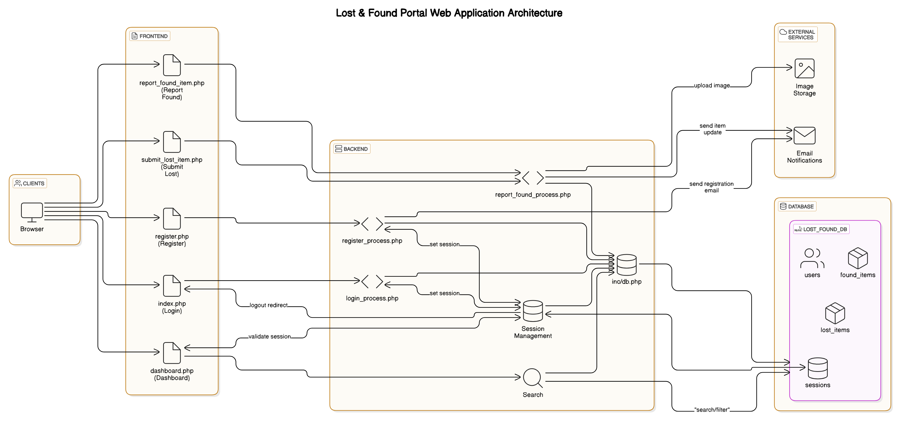
ARCHITECTURAL DESIGN FOR PROPOSED SYSTEM
Date Slide Number

Slide 10
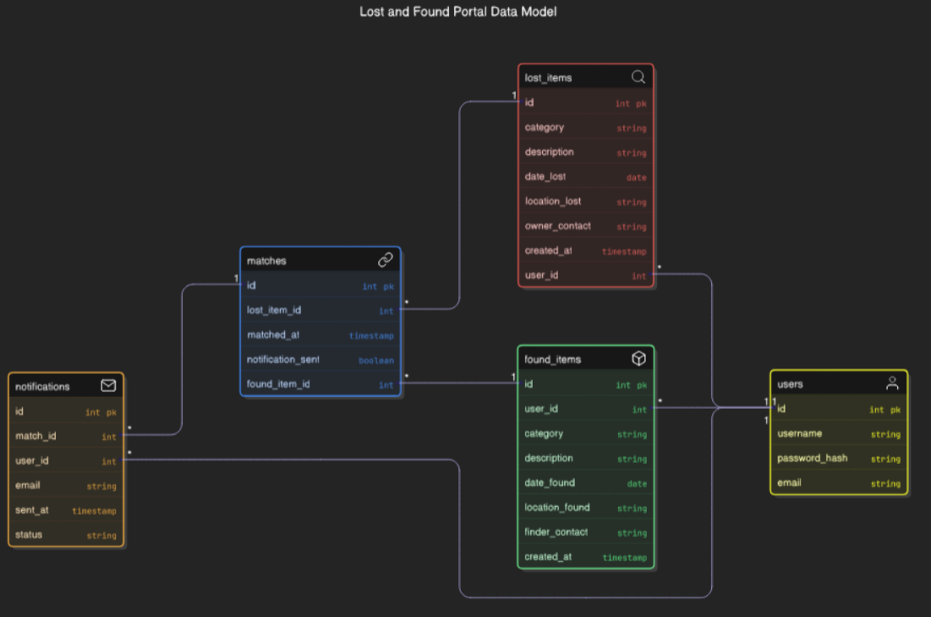
ER CASE DIAGRAM
Date Slide Number

Slide 11
ADVANTAGE OF PROPOSED SYSTEM
Centralized Management
Provides a single digital platform to manage all lost and found items, improving organization and accessibility.
Real-Time Updates
Users can instantly submit and view reports, reducing delays compared to manual reporting methods.
Improved Communication
Email notifications ensure users are alerted when a matching item is found, increasing the chances of recovery.
Secure and Controlled Access
User authentication ensures that only authorized individuals can report or manage items, protecting data integrity.
User-Friendly Interface
Built with Bootstrap for responsive design, ensuring ease of use on both desktop and mobile devices.
Date Slide Number

Slide 12
Results and Discussions
The Lost & Found Portal project successfully delivers a functional web-based platform that allows users to report and search for lost or found items through a simple and secure interface. Built using PHP, MySQL, HTML/CSS, and Bootstrap for responsive design, the system enables user registration, login authentication, session management, and structured item submissions with image support. The backend ensures data consistency and uniqueness, particularly via email validation during registration. Users can report found items, view submissions in a dashboard, and securely log out, ensuring a seamless user experience. The project not only demonstrates key web development principles but also offers a practical solution for lost-and-found item management in real-life environments like campuses or communities
Date Slide Number

Slide 13
Conclusion
The Lost & Found Portal is a simple and effective web application that helps users report and find lost items easily. It provides essential features like user registration, login, item submission with images, and a user-friendly interface, making it a practical solution for managing lost and found items in schools, offices, or communities.
Date Slide Number

Slide 14
THANK YOU
Date Slide Number

